Slide 1


Improving the Culture of Safety: from Transport Staff to Chairman
BETH ISRAEL DEACONESS
MEDICAL CENTER
A member of CAREGROUP
HARVARD
MEDICAL
SCHOOL
Bettina Siewert, MD
Vice Chair for Quality and Safety
in Radiology
Suzanne Swedeen, RN, MSN
Quality Improvement Specialist
In Radiology

Slide 2






Culture of Safety Project
Timeline
Survey development
and
preparation
at meetings
2 SREs revealed barriers
Presentation of survey results at staff meetings
Begin
Implementation of countermeasures
Survey
open
Safety work group
Sept/Nov ’14
June ‘15
Jan/Feb ‘15
March ‘15
Oct’15 – Nov ‘16
April ’17

Slide 3
The Survey
How many staff do not feel comfortable speaking up?
How often
do staff not speak up?
What are the barriers?
Human factor barriers
Unclear responsibility within
the team
Lack of language skills
Fear of retaliation
Fear of disrespect
- Lack of professionalism
Fear of challenging authority
High reporting threshold

Slide 4
Survey Results
“How likely are you to speak up?”
%
50% of staff do not speak up all the time
346 of 648 (56%) of employees completed the survey

Slide 5
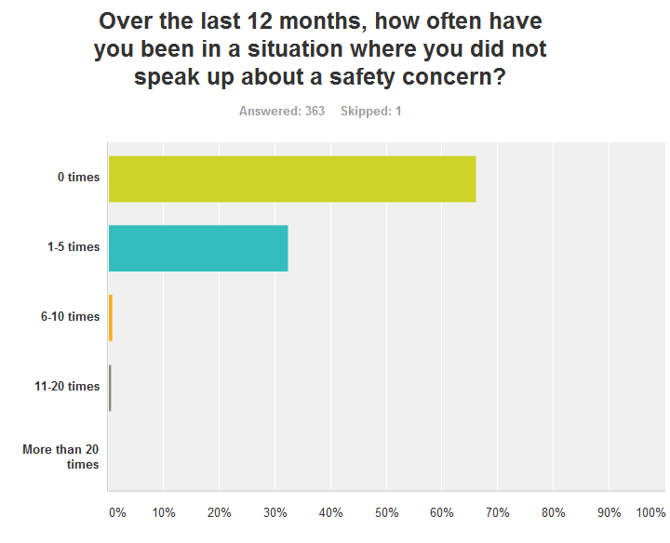
Survey Results
184- >690 errors
are not reported
annually

Slide 6
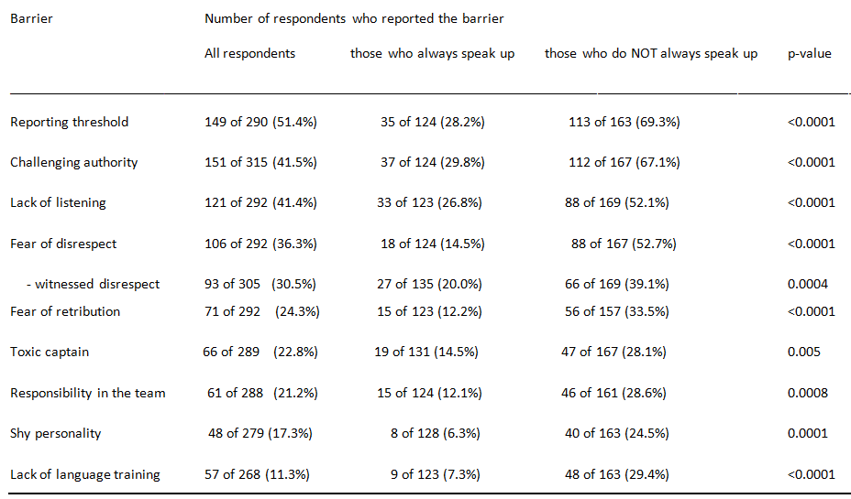
Survey Results

Slide 7

Responsibility within the Team
29% of staff do not consider safety part of their job
“consider safety the responsibility of attending physician staff alone”
Solution
Setting clear expectations
- code of conduct, employee orientation, staff evaluations
Positive reinforcement
- personal “Thank you!”, employee of the month, spot bonus, newsletter story

Slide 8
Lack of Language Training
29% of staff do not know how to raise a concern
Solution
Language scripts
- TeamSTEPPS
Locally specific language
- Staff member: “Dr. X may I assist you?”
- Dr. X: “What would you like to assist me with?”
Or
- “Can we review the images on the large screen outside the room?”

Slide 9
Fear of Retaliation
34% of staff are afraid of retaliation
Solution
Documented: Institutional policy against retaliation
Perceived: Culture of transparency
-- Expressing appreciation “Thank you for bringing this to my attention!”
-- Consistent/open messaging around processes (assignments/scheduling)
-- Avoid mixed messages
--Timely follow-up communication
Notes:
How to gain trust:
Saying you will do something and doing it

Slide 10
Lack of Listening
52% of staff are concerned with lack of listening
Solution
Language script
Make eye contact, align body language
“Thank you for bringing this to my attention”
“What I hear you saying is ….”
“Do I understand correctly that you are concerned about X…?”
“I agree with using Y in this setting.”

Slide 11
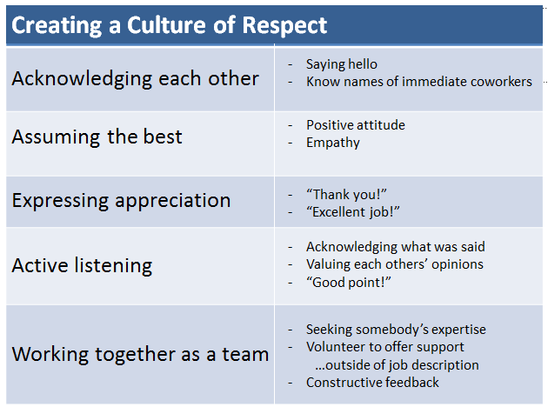
Fear of Disrespect
52% of staff are afraid of experiencing disrespect
- “only 39%” have experienced or witnessed disrespect
Solution

Slide 12
Lack of Professionalism
28% of staff are afraid of disrespect from an individual
Disruptive behavior can be successfully managed¹
70% resolve with 1-3 conversations
15% resolve/improve with guided intervention
15% no change
Solution
Commitment to establishing a process
dedicated personnel
institute of professionalism

Slide 13
Fear of Challenging Authority
67% of staff are afraid of challenging authority
Solution
Building high functioning teams
Understanding safety event reporting as exchange of information among team members
no questioning of competency

Slide 14
High Reporting Threshold
69% of staff do not report an uncertain observation
- Most frequent barrier among physicians
Solution
Acceptance of changing medical practice
“The reality that medicine’s complexity has outgrown our individual capabilities as doctors.” Atul Gawande
Health care redesign through high functioning teams
- team leaders recognize the critical role of other team members
for the success of team performance

Slide 15
Examples of Near Miss Reporting after Implementation of Countermeasures
Wrong side percutaneous nephrostomy
Break in sterility during interventional procedures
Unrecognized anticoagulation prior to procedures
Wrong medication administration
Anaphylaxis to iodinated contrast
“Unsafe” implanted device for MRI
Wrong examination preparation

Slide 16
Critical Success Factors
Setting clear expectations
Positive feedback
- individual, timely
Discussion of “speaking up” metric at QA meetings
- No of near misses on quality scorecard

Slide 17
Remaining Challenges
Remaining challenges | Future work
Time to enter case in database | Shortening forms
Underreporting of near misses | Rebranding as “great catch”
Physician training valuing autonomy, independence and self-reliance | Accepting the complexity of health care
Development of new understanding of team leadership | Leader as facilitator and supporter of high functioning teams

Slide 18

Conclusion
Overcoming barriers to safety event reporting requires
Tools
Language scripts
Active listening
Policies, Processes and Guidelines
Code of Conduct and/or
Mission statement
Staff evaluations
Policy against retaliation
Managing disruptive behavior
Culture
Transparency
Respect
High functioning teams

Slide 19
Quotes
The staff here are amazing. They have saved me from making an error several times.
Doctors listen to what I have to say.
I know my patients are safe here.
The culture is what keeps me here..
I would not want to work anywhere else.
Thank you for your attention!!
bsiewert@bidmc.harvard.edu
sswedeen@bidmc.harvard.edu
This means more to me than a paycheck!

